Slide 1
Google Doodle v2
Starter

Slide 2
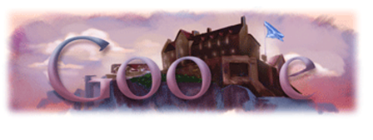
Occasion ?
St. Andrew’s DAY

Slide 3

Occasion ?
Remembrance DAY

Slide 4
Instructions
In pairs
You will be shown 10 Google logos
In the answer sheet provided write down the event / person that the Logo is representing
BE WARNED
  There is only 20 seconds between the logos
  There will be a little clock showing time left in top right

Slide 5
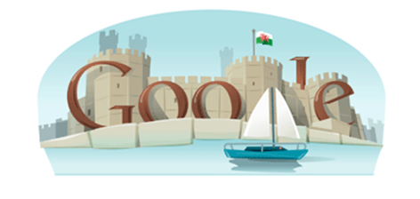


1.Occasion ?

Slide 6

2.Occasion ?

Slide 7

3.Occasion ?

Slide 8
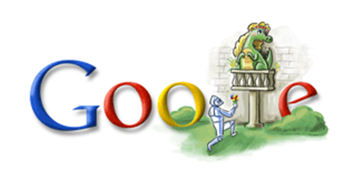
4.Occasion ?

Slide 9

5.Occasion ?

Slide 10
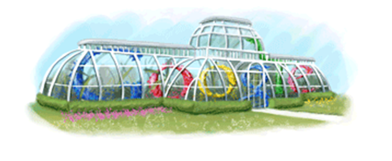
6.Occasion ?

Slide 11
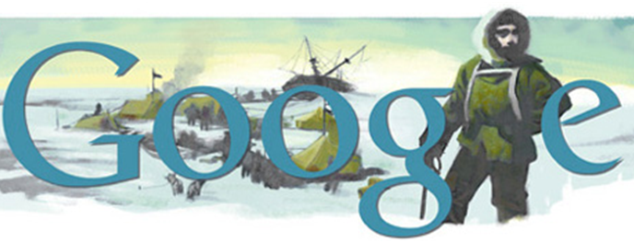
7.Occasion ?

Slide 12
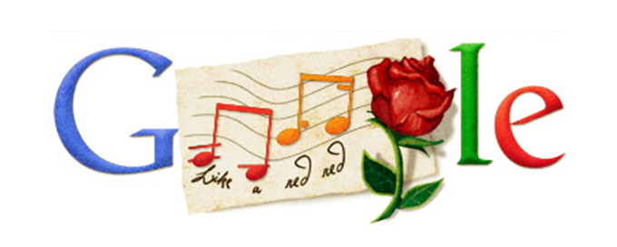
8.Occasion ?

Slide 13
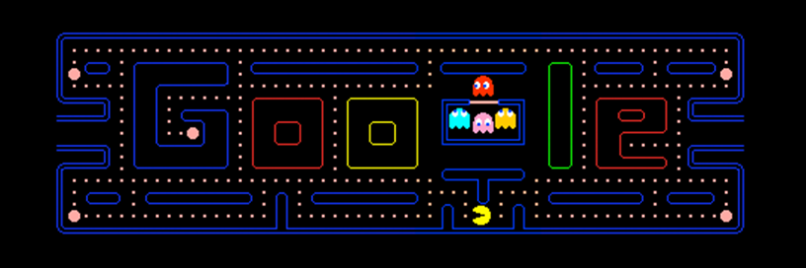
9.Occasion ?

Slide 14
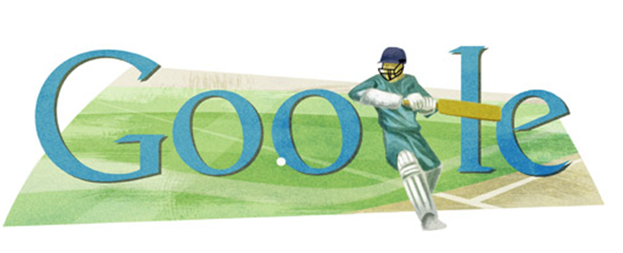
10.Occasion ?

Slide 15
How Did you do?
1 St. David's Day
2 Florence Nightingale’s Birthday
3 Election Day
4 St. Georges Day
5 Big Ben Anniversary
6 Kew Gardens Anniversary
7 Shackleton's Birthday
8 Robert Burns Day
9 PAC-MAN 30th Anniversary
10 World Cricket Cup

